Slide 1
Fashion zone
La Vie Est Belle
The complete fashion apparel website
Using PHP
PRESENTED BY :-
PRANAY AGRAWAL
ADITYA NAYAK

Slide 2
PHP Introduction
PHP is a server-side scripting language designed for web development.
PHP is now installed on more than 244 million websites and 2.1 million web servers.
PHP originally stood for Personal Home Page,^{[4]} it now stands for PHP: Hypertext Pre-processor.
PHP commands can be embedded directly into an HTML source.
PHP files can contain text, HTML, CSS, JavaScript, and PHP code.
PHP is especially suited to server side web development where it generally runs on a web server.
PHP costs nothing, it is free to download and use.
PHP runs on different platforms.

Slide 3

Why I choose PHP???
Others
PHP

Slide 4
Advantages of PHP
Only Web development
Open Source
There are good tools available
Codes and solutions are easily available
Fast installation and setup for development
Lots and lots of knowledge and documentation
Widely available
Speed of development

Slide 5





Working Of PHP
File System
Clint PC
MY Sql
Webserver

Slide 6
About Project
It is a website developed in PHP to provide E-commerce solutions to the user on world wide.
Easy to access and very user friendly UI.
It is well optimized.
.

Slide 7
Project Scope
To provide consistent & quality content.
To provide service quality standards and maintenance.
To provide more self-serve feature.
Create an integrated web site that project a consolidated and consistent image.
To increase visibility of our services options.
Measure traffic.
To provide economical help.

Slide 8
TECHONOLOGY BUILD THE PROJECT
FRONT END
PHP
BACK END
MySQL(database)
Apache Web Server
Java Script
HTML AND CSS

Slide 9
SOFTWARE AND TOOLS
Google Chrome
Dreamweaver
XAMPP

Slide 10
XAMPP
XAMPP is a free and open source cross platform web application.
XAMPP is used for web development on our local machine.
XAMPP is an acronym for
X
A
M
P
P
Cross Platform
Apache Http Server
MySQL
PHP
perl

Slide 11
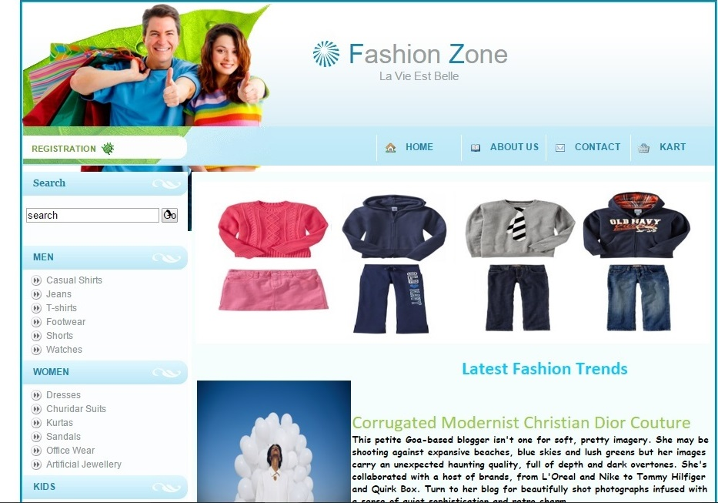
SNAPSHOTS (Home Page)

Slide 12
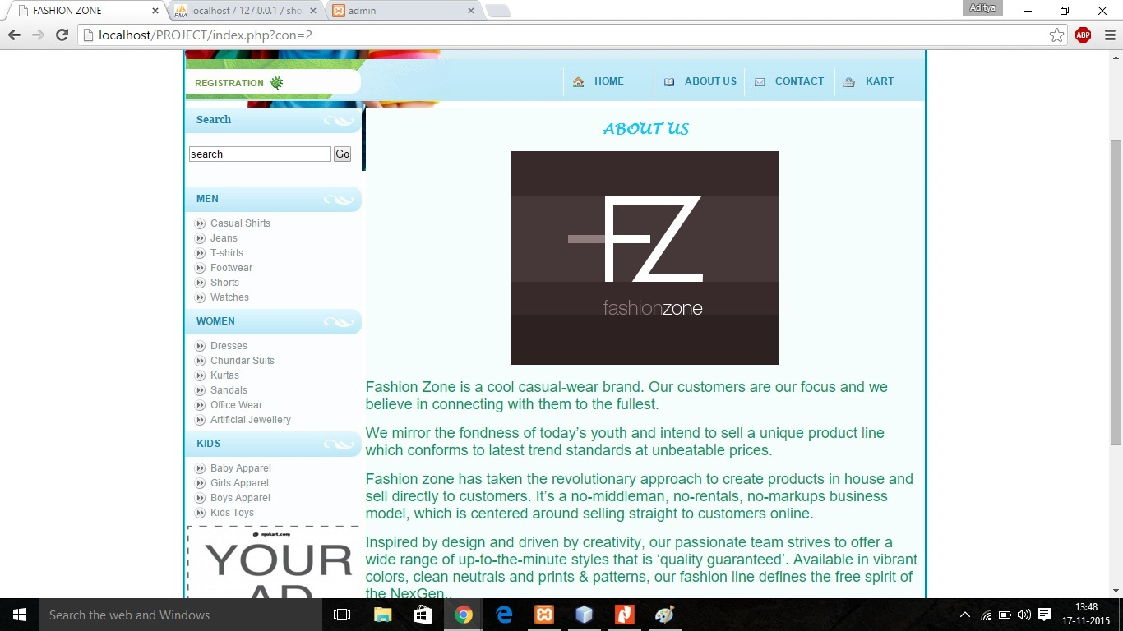
About

Slide 13
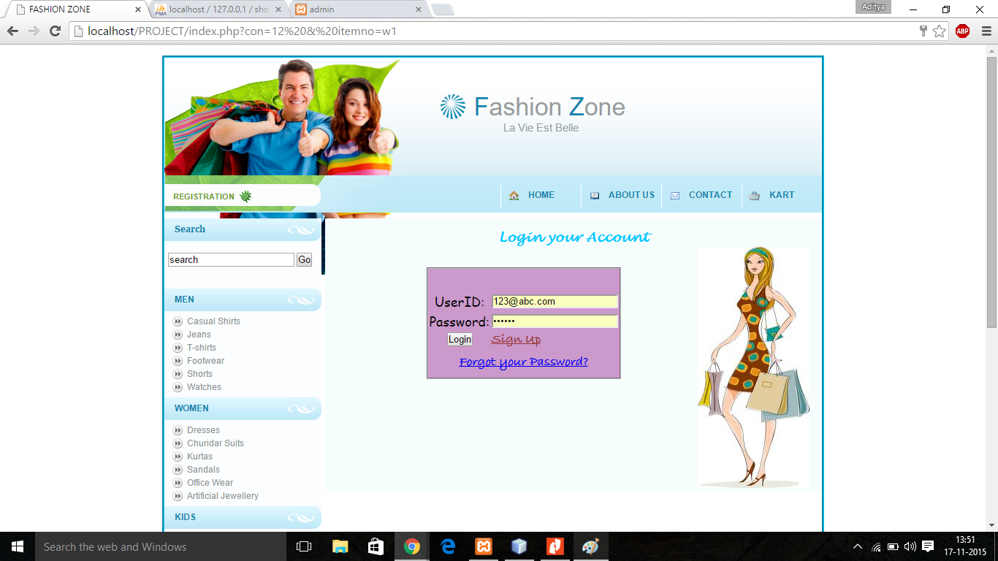

Slide 15


Queries??

